Slide 1

Exploratory Data Analysis
G2M insight for Cab investment firm
27 June 2021

Slide 2
Problem statement/Case Study
The Client XYZ is a private firm in US. Due to remarkable growth in the Cab Industry in last few years and multiple key players in the market, it is planning for an investment in Cab industry and as per their Go-to-Market(G2M) strategy they want to understand the market before taking final decision.
Objective:Provide actionable insights to help XYZ firm in identifying the right company for making investment.
Cab Companies:
Yellow Cab
Pink Cab

Slide 3
The analysis is divided into the following sections:
Data understanding and data exploration
Exploratory data analysis
Hypothesis testing
Recommendations
Model building

Slide 4
Data Understanding and Data exploration
There are 4 datasets :
Cab_Data.csv-The dataset contains 359392 observations/rows and 7 fields/columns. This dataset contains transaction details for each cab type.
Customer_ID.csv-The dataset contains 49171 rows/observations and 4 fields/columns.This dataset contains demographic details of each customer.The column Customer ID is the unique identifier or sometimes called Primary Key for this dataset.
Transaction_ID.csv-The dataset contains 440098 rows/observations and 3 fields/columns.This dataset maps with the Customer_ID.csv dataset on the Customer ID field/column. Column ID is a Foreign Key to the Customer_ID.csv dataset and the Transaction ID column is a Primary Key.
City.csv-The dataset contains 20 rows/observations and 3 fields/columns. Its contains a list of cities, the population of the cities and the number of cab users in U.S.

Slide 5
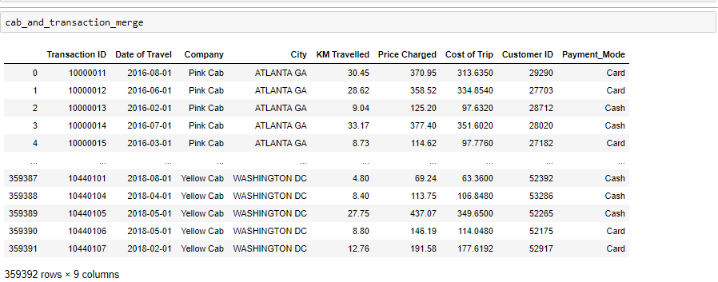
Joining datasets
Merging is required to join datasets.
First merge performed between the Cab_Data.csv and Transaction_ID.csv datasets.
Merge on Transaction ID field/column is required.
New dataset called cab_and_transaction_merge.

Slide 6
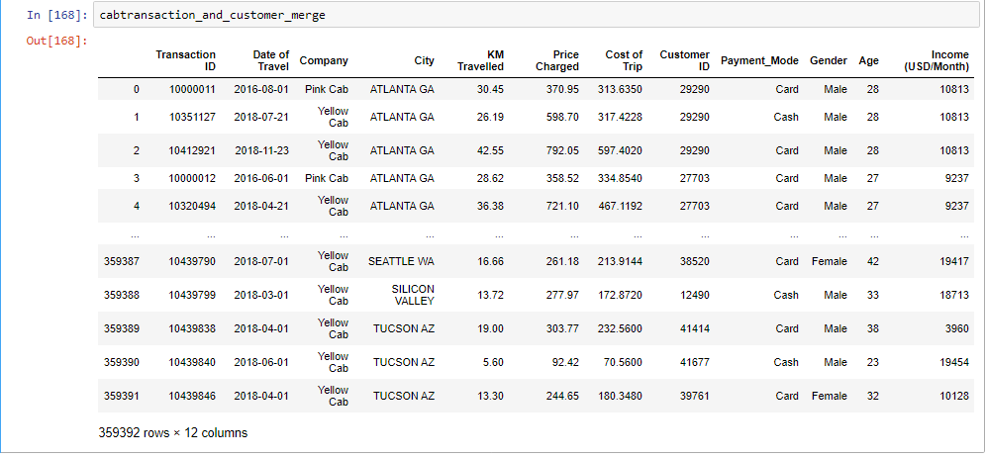
Next merge performed between the cabtransaction_and_customer_merge and the Customer_ID.csv datasets.
Merge on Customer ID field/column is required.
A new dataset called cabtransaction_and_customer_merge.

Slide 7
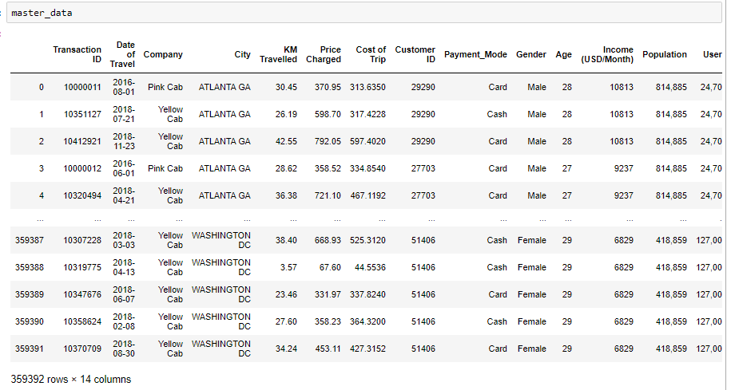
Next merge between the cabtransaction_and_customer_merge and the City.csv dataset.
Merge is performed on City field/column.
The new final dataset called master_data.

Slide 8
Insertion of new columns and renaming columns
3 new columns/fields inserted:
Month-Month number of the year 1-12.
Year-from 2016 to 2018.
Margin-The profit made.To calculate Margin/profit=Price Charged-Cost of Trip.
The new updated master_data now has 17 columns.

Slide 9
Exploratory Data Analysis(EDA)
We need to first split a data between the Yellow and the Pink cab company before we perform our exploratory data analysis.
Once that is done than it becomes easier to make some comparisons.
Some aggregate functions can make comparisons much easier:
Sum
Average
Total Price Charged for Yellow cab and Pink cab:
Yellow cab:125853887.18999998 $(U.S Dollars)
Pink cab: 26328251.329999994 $(U.S Dollars)
We find a higher Total Price Charged in a Yellow cab and the difference is 99525635.85999998 $(U.S Dollars).
Total Margin for Yellow cab and Pink cab:
Yellow cab: 44020373.17080002 $(U.S Dollars).
Pink cab: 5307328.321 $(U.S Dollars).
We find a higher Margin/Profit in a Yellow cab and the difference is 38713044.84980002$(U.S Dollars)

Slide 10
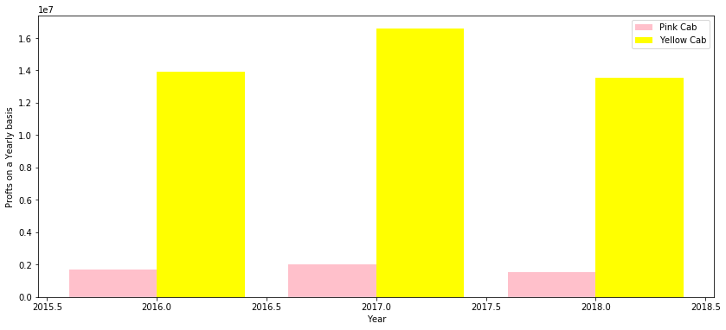
Profit analysis on a yearly basis
We see a very high total profits generated each year for the Yellow cab compared with that of the Pink cab.
Impacts a lot on the business performance.

Slide 11
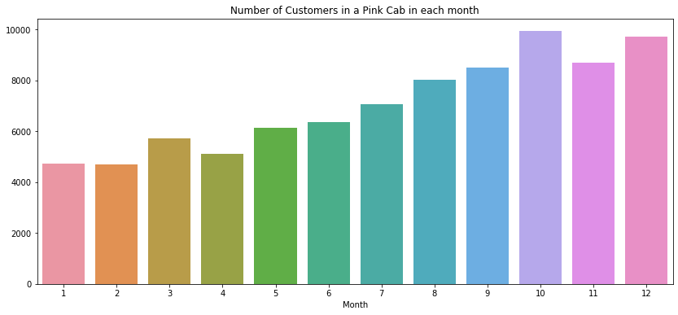
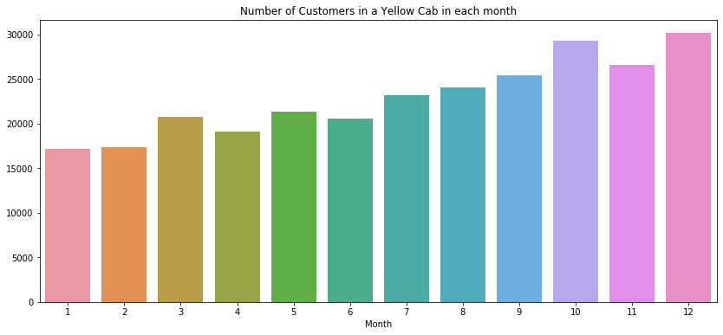
Analysis of a number of cab users in a monthly basis

Slide 12
From the graph above we see the Yellow cab has a higher number of cab users
The range in a number of cab users for the Yellow cab is higher than that of the Pink cab.
Yellow cab ranges from 17108 to 30135 cab users.
Pink cab ranges from 4734 to 9729 cab users.

Slide 13
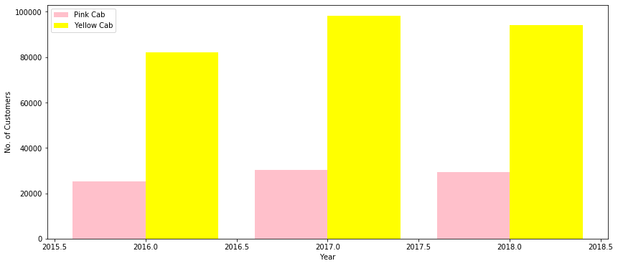
Analysis of a number of cab users on a yearly basis
Higher number of cab users travelling in a Yellow cab.
There is a very high range in between the number of cab users in a Yellow cab and a Pink cab.
Pink cab ranges from 25080 to 30321 cab users from the year 2016 to the year 2018.
Yellow cab ranges from 82239 to 98189 cab users.

Slide 14
Limitations in analysis for a few cab users
Determining the number of cab users by identifying them by their unique Customer ID has some limitations.
Does not provide accurate statistical analysis.
Not all cab users are included, no representation of the whole population
Need to determine number of cab users for the whole population in U.S.
We can reveal the number of cab users by visualizing using a Pie chart showing the percentages of cab users in each city.

Slide 15
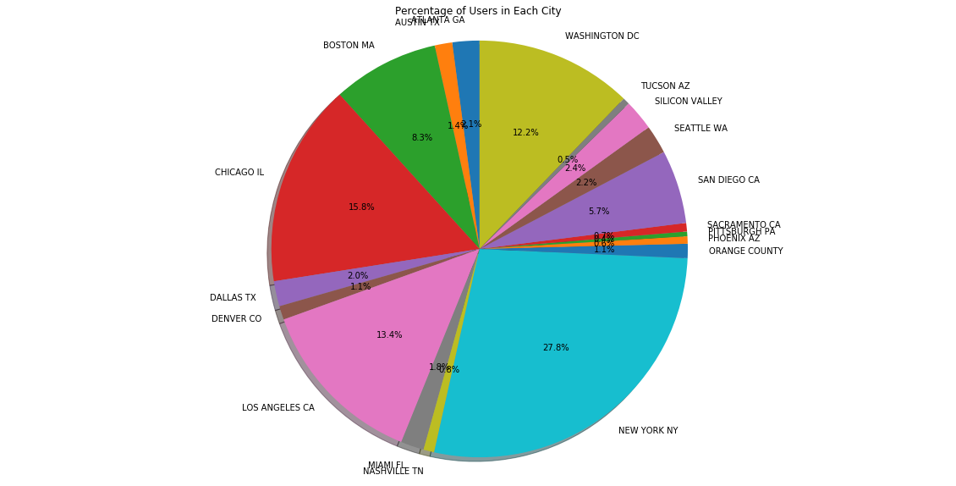
Percentage of cab users in each city
The New York City has a high
percentage of cab users with
27.8% followed by Chicago
With 15.8% and Los Angeles
With 13.4%

Slide 16
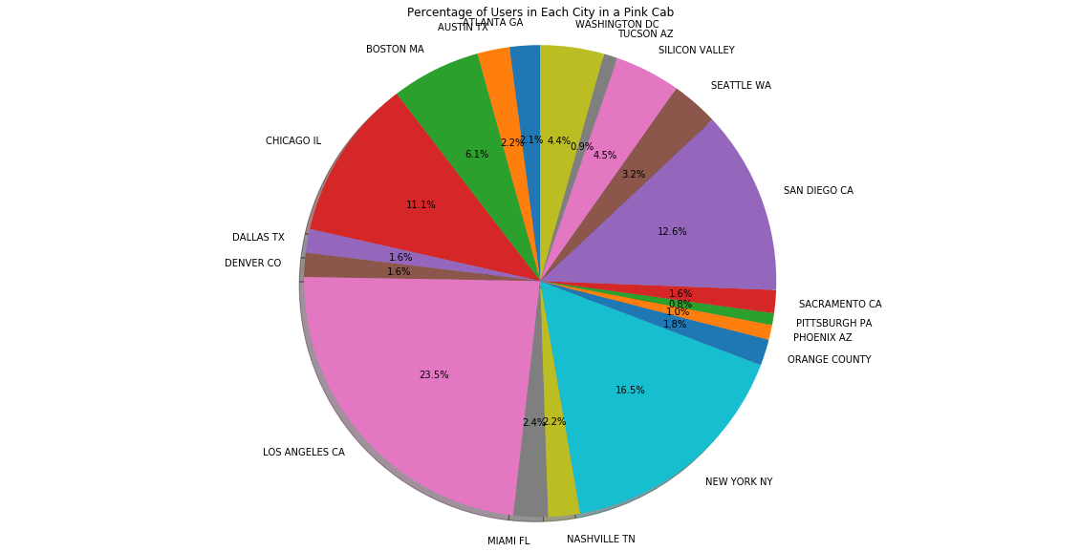
Percentage of cab users in each city travelling in Pink cab
In the LOS ANGELES city the highest percentage of cab users are travelling in a Pink cab with 23.5%.

Slide 17
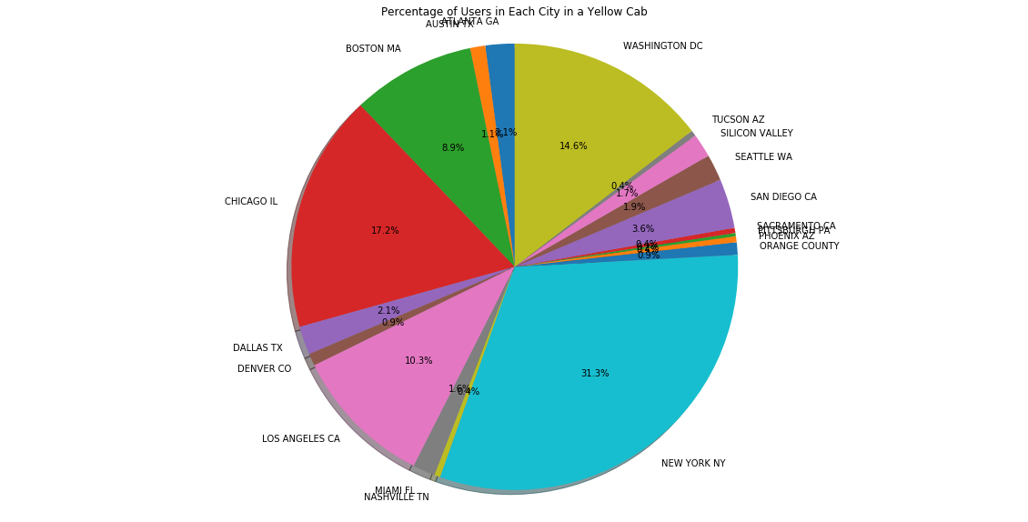
Percentage of cab users in each city travelling in a Yellow cab
In the New York city the highest
percentage of cab users are travelling
In a Yellow cab with 31.3%.

Slide 18
Which cab has most cab users out of whole population in U.S?
Visualizing using a pie chart revealing percentages does not provide answer for determining which cab has the majority of cab users.
Only comparing between cities in U.S.
Need to sum up all the number of cab users in each city for both cabs.

Slide 19
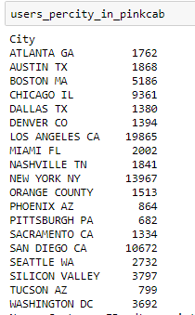
Table representation for a number of cab users travelling in Pink cab in each city

Slide 20
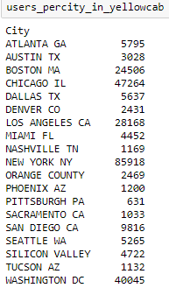
Table representation for a number of cab users travelling in Yellow cab in each city

Slide 21
With the table representation illustrated above, it’s now easier to calculate the total number of cab users representing the whole population.
We sum up all the number of cab users in all cities altogether .
Total number of cab users travelling in Pink cab:84711.
Total number of cab users travelling in Yellow cab:274681.
As we can see, the total number of cab users travelling in a Yellow cab are higher than the ones travelling in a Pink cab.

Slide 22
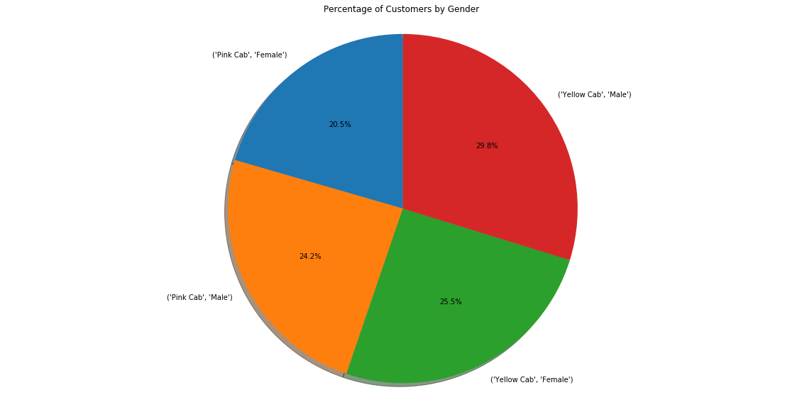
Gender Analysis
Gender is one of the characteristics
in determining customer behavior.
Decision needs to be taken on what
gender groups preference.
Therefore, insights are required to
reveal this.
As shown on a pie chart illustrated the
following is revealed:
In the Pink cab there are 20.5% females
and 24.2% males.
In the Yellow cab there are 29.8% males
and 25.5% females.
There is a higher percentage of males travelling in both Yellow and Pink cab.
This means the male gender group is dominant

Slide 23
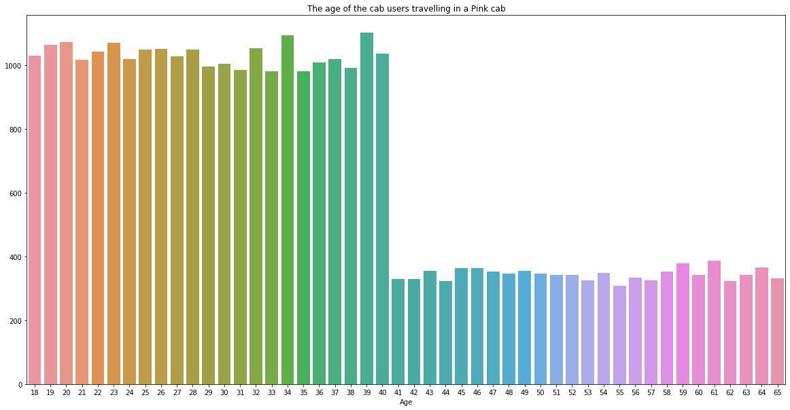
Age analysis for cab users travelling in a Pink cab

Slide 24
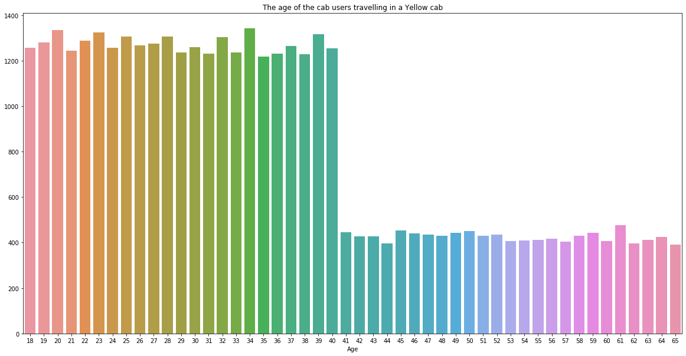
Age analysis for cab users travelling in a Yellow cab

Slide 25
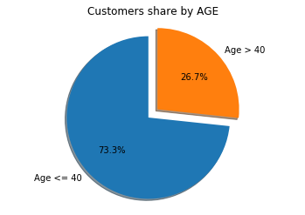
Looking at the graphs above as illustrated we can see as we reach customers
who are more than 40 years of age we see a decrease in a number of cab users
The alternative is by visualizing using a pie chart .We can set the age limit by visualizing as: Age<=40 years or Age>40 years
The Customers share by Age is visualized using a pie chart as illustrated below
We can see that there is 73.3% customers of age less than 40 years and 26.7% customers of age more than 40 years

Slide 26
Income Analysis
Income analysis is one of the characteristics to determine customer behavior.
We need to group the Income Class of cab users into High class and Low class
High class are classified as high-income earners and Low class as low-income earners
Cab users earning less than 10 000 $(U.S Dollars) per month would be classified as Low class and earning above 10 000$(U.S Dollars) per month would be classified as High class

Slide 27
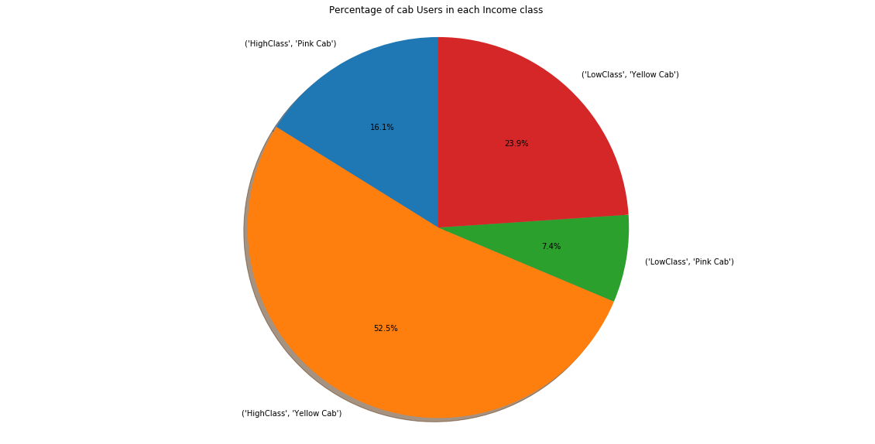
Percentage of cab users in each Income group
Looking at the pie chart as
illustrated, we can see that there
Is a majority of Income group
of cab users belonging to an Income
group of a High class travelling in
Yellow cab
This means that the High Class
Contributes to high investment

Slide 28
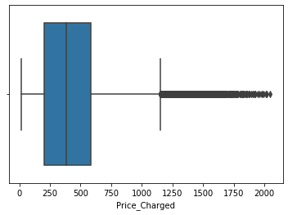
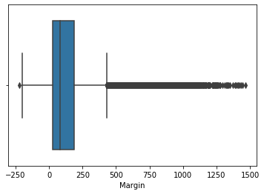
Detection of outliers

Slide 29
We need to check for outliers in numerical values
There are no outliers found in the columns/fields with numerical values except for the columns Price Charged and Margin
The presence of outliers is due to high –end cars

Slide 30
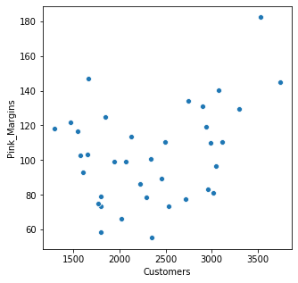
Does margin proportionally increase with increase in number of customers?
As illustrated on the diagram, we see that the Pink cabs increase their margins with an increase in number of customers

Slide 31
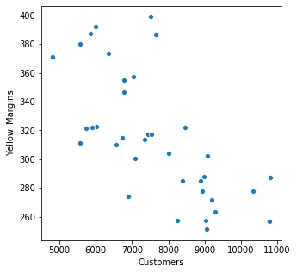
Here as we see, the Yellow cabs decrease their margins with an increase in number of customers

Slide 32
Hypothesis Testing

Slide 33

Is there a difference in margin/profit between male and female customers for Yellow cabs?
There is a difference in margin/profit for the Yellow cab between male and female customers,and therefore we accept the alternate hypothesis.

Slide 34
Is there a difference between gender and KM Travelled for Pink cabs?

Slide 35

Is there a difference in margin/profit between male and female customers for Pink cabs?
We accept the null hypothesis,and therefore there is no difference in margin/profit for Pink cabs between male and female customers.

Slide 36

Is there a difference in margins/profit due to age of customers for Pink cab?
There is no difference is no difference in margin/profit for Pink cab due to the age of customers,and therefore we accept the null
It doesn't make any difference whether the customer is less than equal to 40 or greater than 40.

Slide 37

Is there a difference in profit/margin due to the age of customers for Yellow cabs?
There is no difference in profit/margin for Yellow cabs due to the age of customers,so we accept the null hypothesis.
It aslo doesn't make any difference whether the customer is less than equal to 40 or greater than 40.

Slide 38

Is there a difference between gender and KM Travelled for Yellow cabs?
There is no difference between gender and KM Travelled for yellow cab, so we accept the null hypothesis.

Slide 39

Is there a difference between gender and KM Travelled for Pink cab?
There is a difference between gender and KM Travelled for Pink cabs.

Slide 40
Recommendations

Slide 41
To make a precise decision in which company would be a better investment opportunity,we need to clearly review our figures revealed from the exploratory data analysis
The first exploration was determining the number cab users periodically(monthly and yearly) and our insights revealed as follows:
The Yellow cab resulted in a higher cab users than that of the Pink cab travelling on a monthly basis. The Yellow cab revealed a higher range of cab users than that of the Pink cab
The Yellow cab also resulted in a higher cab users than that of the Pink cab travelling on a yearly basis and revealed a higher range of cab users
On top of that we found higher cab users travelling on a Yellow cab in representation of the whole country in U.S.
Yellow cab had 274681 cab users and the Pink cab had 84711

Slide 42
The Yellow cab generated a higher margin/profit than that of the Pink cab on a yearly basis
From 2016 to 2018 has been generating a very higher profit than that of the Pink cab
So far, the Yellow cab company has been excelling and therefore is a better investment opportunity for XYZ.

Slide 43
Building Predictive Models using Linear Regression, Decision Tree and Random Forest.

Slide 44
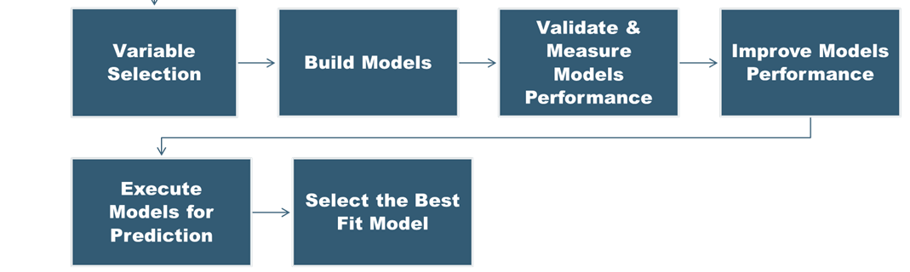
Model Building steps

Slide 45
Model1: Linear Regression
Linear Regression is a method for predicting target value and attempts to model the linear relationship between target and one or more predictors.
In our dataset, Price Charge is the target value and all the other variables are predictors.
Splitting the data into a training set (75%), and test set (25%).

Slide 46
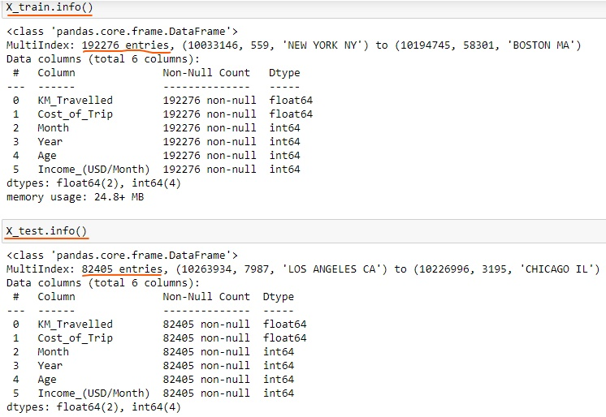
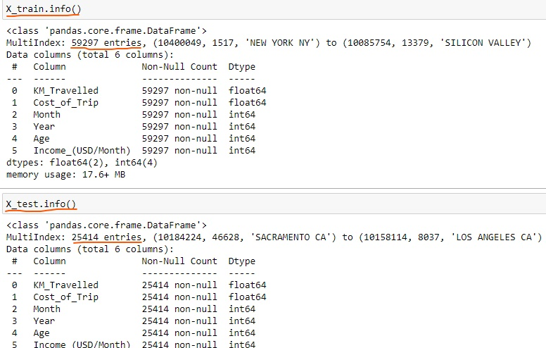
Yellow Cab
Pink Cab

Slide 47
Model2: Decision Tree
Decision tree builds regression models in the form of a tree structure. It breaks down a dataset into smaller and smaller subsets while at the same time an associated decision tree is incrementally developed.
The final result is a tree with decision nodes and leaf nodes.
The topmost decision node in a tree which corresponds to the best predictor for the target value (Price Charged).

Slide 48
Model3: Random Forest
A Random Forest operates by constructing several Decision trees.
A prediction from the Random Forest is an average of the predictions produced by the Decision trees in the forest.

Slide 49
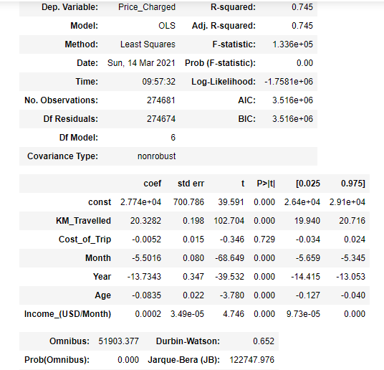
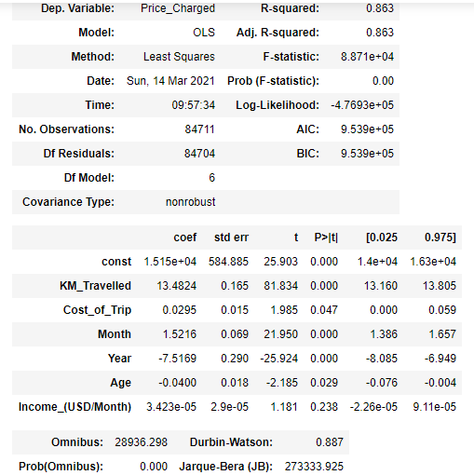
Base Model:
Yellow Cab
Pink Cab

Slide 50
As shown above, As per Base Model:
Cost of Trip, Month, Year, Age, Income are significant variable for Yellow Cab which are the best predictors for Price Charged.
Cost_of_Trip, Year, Age, Income are significant variable for Pink Cab which are the best predictors for Price Charged. Month is not considered significant.

Slide 51
Best Fit Model: RMSE Value & Accuracy
RMSE or root mean square error measures the error which is Prediction values – Actual values.
Lower the RMSE value the better is the Model.

Slide 52
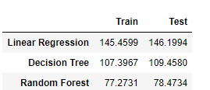
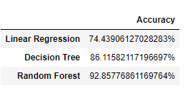
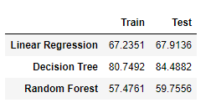
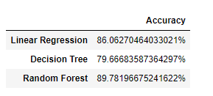
RMSE values & Accuracy for Yellow Cab
RMSE values & Accuracy for Pink Cab

Slide 53
As per the above RMSE data and Accuracy, Random Forest Model is the best fit model for further deployment.
Interpreting Random Forest Model: Cost of Trip, Month, Year, Age, Income are the best predictors for Price Charged.

Slide 54
Thank You

